Slide 1
Magist:
A good Eniac partner?
Eniac Data Department :
Beatriz, Jude and Timothy

Slide 2
Objectives
Is Magist a good Eniac partner for Brazil?
A platform for high-end tech products?
What’s Magist’s ON-TIME delivery KPI?
What about Customer satisfaction?
Magist’s Business scope in Brazil

Slide 3
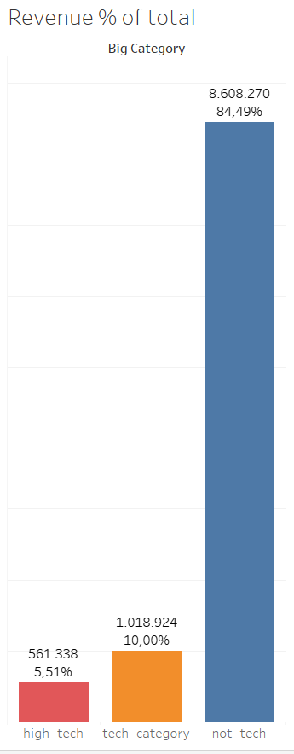
Magist Products:Revenue
General Revenue: 13.5M (6,75M/year)
Tech products:10% of total revenue
High-end-Tech (price >= 500€): 5.5% of total revenue
Other products account for the highest share of Magist revenue
Typical prices in Magist are:
120€ for all items
80.9€ for tech items

Slide 4
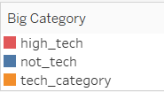
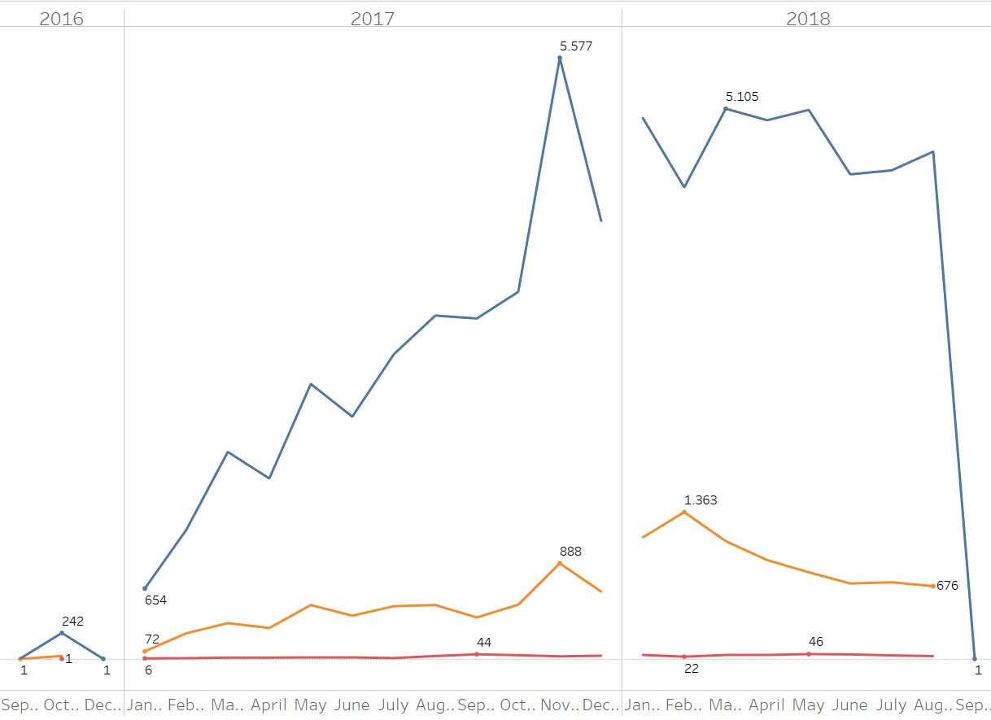
Magist Products: Growth
Amount of tech products sold:
Below average (avg= 2.340/month)
These numbers refer to a period of 26 months (09.2016 - 10.2018) ↝ approx. 2 years
Notes:
Mostly sold items are “not-tech” and around €120

Slide 5
Sellers
There are 584 Tech Sellers which is 18.9% out of the sellers
The total amount earned by Tech Sellers between 2016 - 2018 is €2.1M

Slide 6
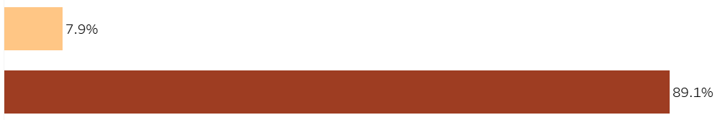
Magist on-time delivery KPI: 89.1%
Standard KPI for ON-TIME DELIVERY: 97% (source ISO 9001)
7835 late deliveries within a period of 26 months (09.2016 - 10.2018)
12.5 days average time from when an order is placed to when it’s delivered
Late delivery
On-time delivery

Slide 7
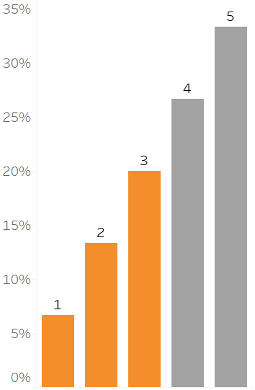
Customer satisfaction
40% of Customer reviews range between 1 and 3 stars.
11571 one star reviews between
6.67 % of the total review scores

Slide 8
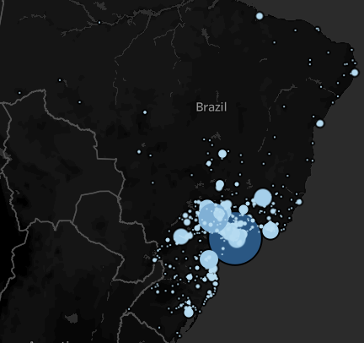
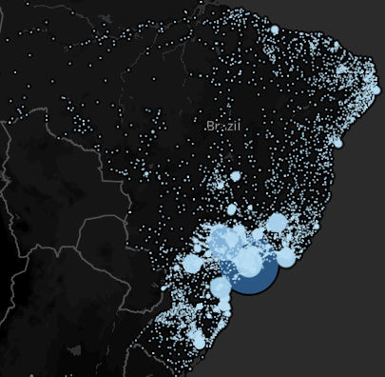
Magist’s Operations are confined to SE Brazil
A: Magist’s operations
B: Brazil’s 5570 cities

Slide 9
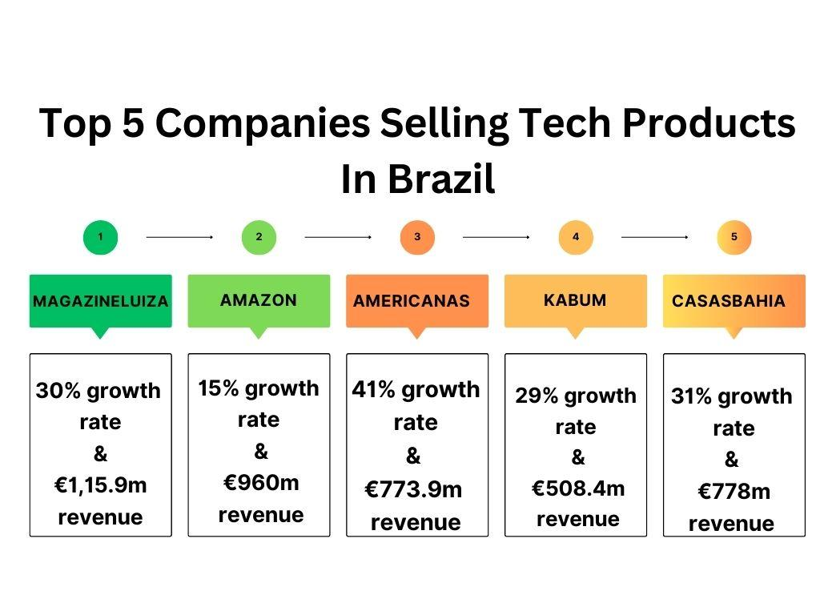
Brazil’s tech market positioning:
Where is Magist?
Source: ecommercedb

Slide 10
Summary & Recommendations
It's evident that there are significant concerns and risks that must be considered.
Our recommendation is that we exercise caution and explore alternatives (like Amazon or Americanas) that align more closely with our vision for the Brazilian market.
In this way, we are sure that we position Eniac for sustained success in Brazil.
Thank you for listening!
Notes:
Comments to “a” : Magist has a below standard on-time delivery KPI of 89.1%
40% of customer dissatisfaction as evidenced by the 1 - 3 star reviews
business activities seem to be confined to SE Brazil

